Slide 1
CS 211 Computer Architecture Lecture 7: The Von Neumann Architecture- Part 1
Ravi Mittal
ravi.mittal@iitgoa.ac.in
Indian Institute of Technology, Goa

Slide 2
Reading
Patt and Patel book, Chapter 4, “The von Neumann Model”
Lecture slides of Prof Onur Mutlu, Course 18-447, Computer Architecture, Carnegie Mellon University

Slide 3
In today’s class, we will study
Von Neumann Model
Parts
Model Diagram
Memory
Processing Unit
Input and Output
Control Unit
Properties of the model
Von Neumann Machine
LC3- Learning Computer3

Slide 4
Introduction: Von Neumann Model

Slide 5
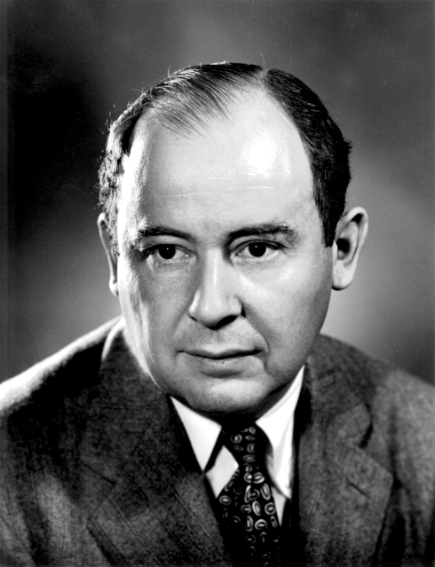
Von Neumann Model
John von Neumann proposed a fundamental model in 1946
It consists of 5 parts
Memory
Processing unit
Input
Output
Control unit
Burks, Goldstein, von Neumann,
“Preliminary discussion of the logical design
of an electronic computing instrument,” 1946.
From Prof Onur Mutlu’s presentation

Slide 6
The Von Neumann Model
MEMORY
Mem Addr Reg
Mem Data Reg
INPUT
Keyboard,
Mouse,
Disk…
PROCESSING UNIT
OUTPUT
Monitor,
Printer,
Disk…
ALU
TEMP
CONTROL UNIT
PC or IP
Inst Register
From Prof Onur Mutlu’s presentation

Slide 7
The Von Neumann Model
MEMORY
Mem Addr Reg
Mem Data Reg
INPUT
Keyboard,
Mouse,
Disk…
PROCESSING UNIT
OUTPUT
Monitor,
Printer,
Disk…
ALU
TEMP
CONTROL UNIT
PC or IP
Inst Register
From Prof Onur Mutlu’s presentation

Slide 8
Accessing Memory: MAR and MDR
There are two ways of accessing memory
Reading or loading
Writing or storing
Two registers are necessary to access memory
Memory Address Register (MAR)
for addressing individual locations
Memory Data Register (MDR)
For holding the contents of a memory location on its way to/from the storage

Slide 9
Accessing Memory: MAR and MDR
To read
Step 1: Load the MAR with the address
Step 2: Data is placed in MDR
To write
Step 1: Load the MAR with the address and the MDR with the data
Step 2: Activate Write Enable signal

Slide 10
The Von Neumann Model
MEMORY
Mem Addr Reg
Mem Data Reg
INPUT
Keyboard,
Mouse,
Disk…
PROCESSING UNIT
OUTPUT
Monitor,
Printer,
Disk…
ALU
TEMP
CONTROL UNIT
PC or IP
Inst Register

Slide 11
Processing Unit
The processing unit can consist of many functional units
Arithmetic and Logic Unit (ALU), executes computations
MIPS: add, sub, mult, and, nor, sll, slr, slt…
RISC-V: add, sub, mult, and, or, sll, ..
The ALU processes quantities that are referred to as words
Word length
LC-3: 16 bits
MIPS: 32 bits
Intel x86-64: 64 bits
RISC-V: 32 bits (Extension: 64 bits, 128 bits)
Temporary storage (Scratch pad): Registers
E.g., to calculate (A+B)*C, the intermediate result of A+B is stored in a register
Notes:
32 bits (Pentium IV) or 64 bits (Itanium, IA-64) in real systems
sll: shift left logical
slr: shift right logical
Slt: set on less than

Slide 12
Registers (Temp)
Memory is big but slow
Registers
Operate at processor speed – Clock speed
Ensure fast access to operands
Each Register size = Word length = say 32 bits (in RISC-V)
Register set or file
A set of registers
Not too many registers
32 Registers in RISC-V

Slide 13
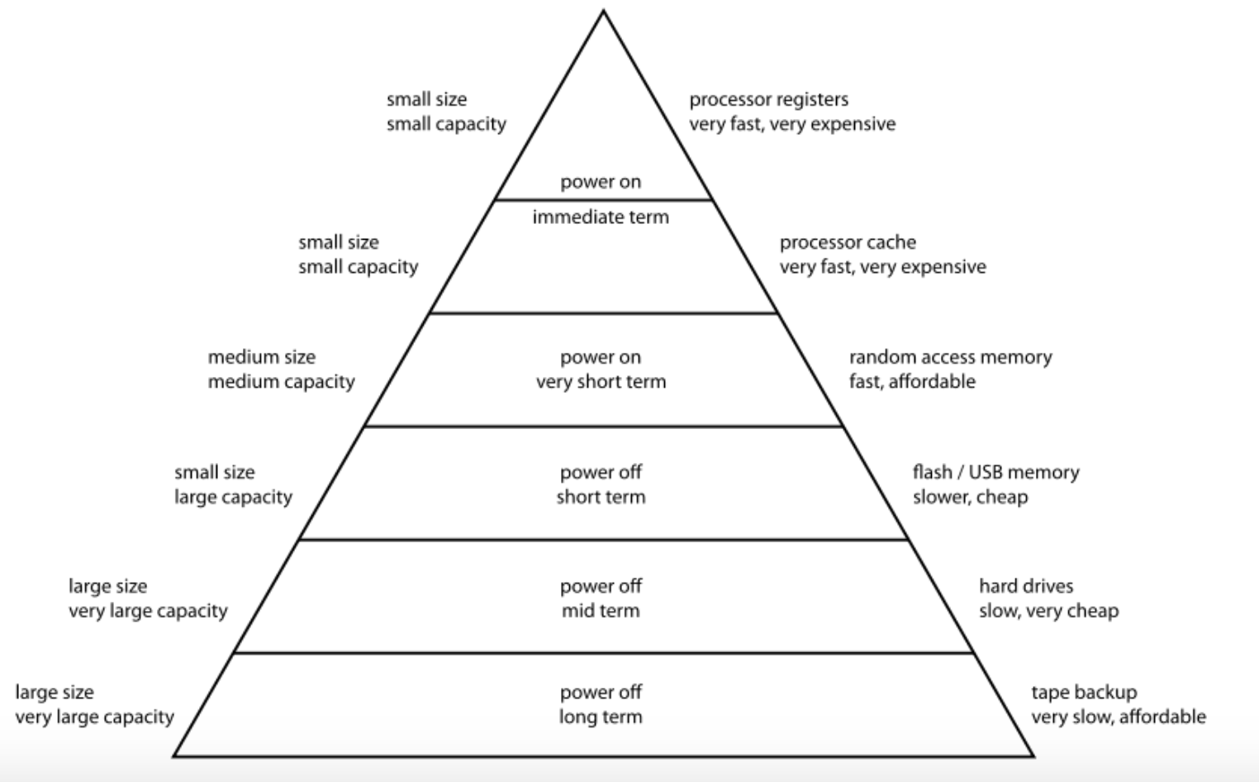
Register Access time: approx. 0.1 ns
One clock cycle
SRAM Cache Access time: 1-2 ns
DRAM Access time : 50-150 ns
SSD Access time : 40-100 micro second
Hard Disk Access time : 10-15 milli second
Tape Access time : 50-60 seconds

Slide 14
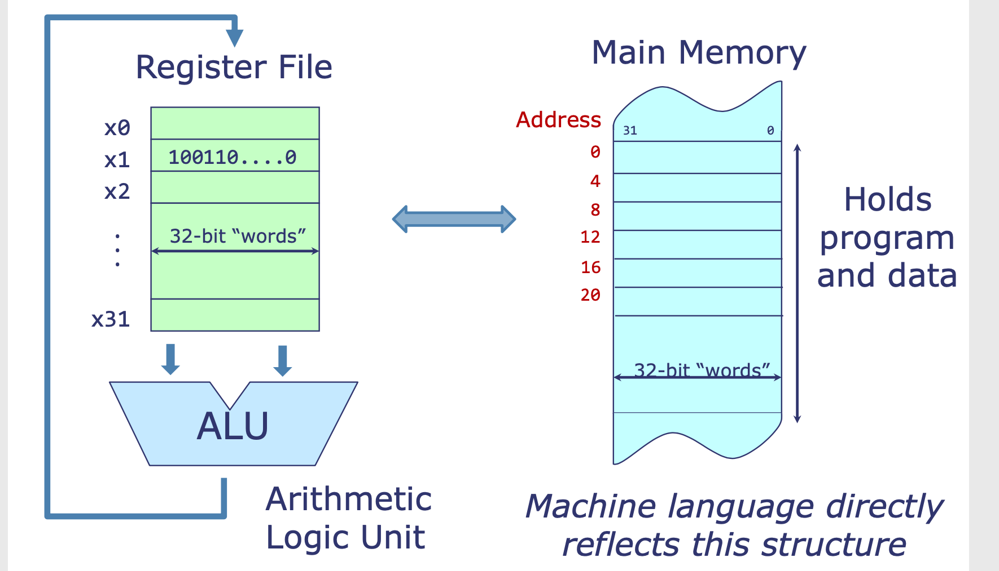
Register File Interactions
Three main instructions:
Arithmetic and Logical
Load and Store
Control Transfer
Load and Store Machine
Notes:
Memory is slow
Registers are fast – work at processor speed
So, Contents (Instruction and data) are brought from MM to Registers.
Also, contents (data) is stored from Registers to MM
Memory contains both program and data

Slide 15
Input and Output
Many devices (Peripherals) can be used for input and output
Input
Keyboard
Mouse
Scanner
Disks, etc
Output
Monitor
Printer
Disks, etc.

Slide 16
The Von Neumann Model
MEMORY
Mem Addr Reg
Mem Data Reg
INPUT
Keyboard,
Mouse,
Disk…
PROCESSING UNIT
OUTPUT
Monitor,
Printer,
Disk…
ALU
TEMP
CONTROL UNIT
PC or IP
Inst Register

Slide 17
Control Unit
The control unit is similar to the conductor of an orchestra
It conducts the step-by-step process of executing (every instruction in) a program
It keeps track of
where we are within the process of executing the program
Program Counter (PC): contains the address of the next instruction to be executed. Also, called Instruction Pointer (IP)
IR (Instruction Register): to keep track of the instruction being executed
where we are in the process of executing each instruction
As execution of an instruction involves many activities

Slide 18
Control Unit
Reads an instruction from memory
the instruction’s address is in the PC
Interprets the instruction, generating control signals that tell other components what to do
An instruction may take many machine cycles to complete
Operation is either executed completely or not at all
Instruction execution is atomic

Slide 19
The Von Neumann Model/Architecture: Properties
Also called Stored Program Computer (instructions in memory)
Two key properties:
Stored program
Instructions stored in a linear memory array
Memory is unified between instructions and data
The interpretation of a stored value depends on the control signals
Sequential instruction processing
One instruction processed (fetched, executed, and completed) at a time
Program counter (instruction pointer) identifies the current instruction
Program counter is advanced sequentially except for control transfer instructions (eg. Jump or branch)
When is a value interpreted as an instruction?
From Prof Onur Mutlu’s presentation

Slide 20
Programmer visible (Architectural) State
M[0]
M[1]
M[2]
M[3]
Registers
Given special names in the ISA (as opposed to addresses)
General vs. special purpose
M[4]
M[N-1]
Memory
array of storage locations
indexed by an address
Program Counter
memory address
of the current instruction
Instructions (and programs) specify how to transform
the values of programmer visible state
From Prof Onur Mutlu’s presentation

Slide 21
LC-3 Von Neumann Machine

Slide 22
LC-3: A Von Neumann Machine
MAR contains 16 bits
Can address 2¹⁶ locations (address space)
The MDR contains 16 bits
each memory location contains 16 bits
Word size = 16 bits
LC-3 is 16-bit addressable (word addressable)
INPUT/OUTPUT consists of a keyboard and a monitor
Keyboard: requires two registers: KBDR and KBSR
KBDR: Keyboard Data Register
For holding the ASCII codes of key stuck
KBSR: Keyboard Status Register
For maintaining status information about the key stuck
Monitor: Two registers: DDR and DSR
DDR (Display Data Register): for holding the ASCII code of something to be displayed on the screen
DSR (Display Status Register): for maintaining associated status info

Slide 23
LC-3: A Von Neumann Machine
The control Unit
Finite State Machine - Most important structure
Directs all activities
Processing is carried out step by step, clock cycle by clock cycle
Note that CLK is input to the FSM
Input to FSM is Instruction Register (IR)
Instruction being processed – determines what activities must be carried out
PC (Program Counter) is also part of the control unit – keeps track of the next instruction to be executed after the current instruction finishes
The output of FSM are control signals – shown with non-filled arrow head
These outputs control the processing throughout the computer

Slide 24
LC-3: A Von Neumann Machine
From Prof Onur Mutlu’s presentation
Program Counter
Control signals
(non filled-in Arrow head)
8 General Purpose Registers (GPR)
Data
(filled-in Arrow head)
Finite State Machine
(for Generating Control Signals)
Instruction Register
ALU: 2 inputs, 1 output
ALU operation
GateALU
Memory Data Register
Keyboard
KBDR (data), KBSR (status)
Memory Address
Register
Monitor - Display
DDR (data), DSR (status)
16-bit addressable
Notes:
The data path consists of all components that actually process the information during each clock cycle—the functional units that operate on the information, the registers that store information at the end of one cycle so it will be available for further use in subsequent cycles, and the buses and wires that carry information from one point to another in the data path.

Slide 25
Lecture Summary
In this lecture, we have studied Von Neumann Model
Parts: Memory, Processing unit, Input, Output, Control unit
Memory Unit contains two registers: MAR and MDR
Both registers are used for reading and writing to/from memory
Processing Unit contains ALU and Registers
Registers operate at processor’s speed – very fast – limited in number – Register File
Control Unit
Conductor of an Orchestra – Generates control signals to execute each instruction
Stored Program Concept
Von Neumann Machine – One simple implementation
LC3 – Learning Computer 3

